Slide 1
Research Data Context Preservation in SCAPE
Catherine Jones, Science and Technology Facilities Council, UK (STFC)
IPres 2013: Lisbon

Slide 2
SCAPE: Scalable Digital Preservation
SCAPE is an EU funded project (2011 – 2014)
Exploring preservation issues with large collections of material.
Three testbeds implementing the tools and Taverna workflows utilising the Hadoop platform built elsewhere in the project:
  Web archives
  Large Scale Digital Repositories
  Research Data
Website http://www.scape-project.eu/

Slide 3
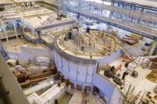
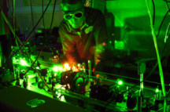
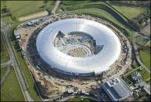
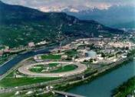
STFC Facilities –
driving scientific research
Neutron Sources
Providing powerful insights into key areas of energy, biomedical research, climate, environment and security
High Power Lasers
Providing applications on bioscience and nanotechnology and demonstrating laser driven fusion as a future source of sustainable, clean energy
Light Sources
Providing new breakthroughs in medicine, environmental and materials science, engineering, electronics and cultural heritage
Notes:
We are a science-driven organisation, making it possible for a broad range of scientists to do the highest quality research tackling some of the most fundamental scientific questions. We provide access to world-class facilities in the UK including
Neutron and Muon Sources
Lasers
Computational Science and Engineering
Atmospheric, Astronomy and Space Science
Synchrotron light sources and free electron lasers
Materials Analysis
Neutron Sources
Providing powerful insights into key areas of energy, biomedical research, climate, environment and security.
ISIS - Pulsed Neutron and Muon Source
Target Station 2
High Power Lasers
Providing applications on bioscience and nanotechnology
Central Laser Facility
Demonstrating laser driven fusion as a future source of sustainable, clean energy
HiPER
Light Sources
Providing new breakthroughs in medicine, environmental and materials science, engineering, electronics and cultural heritage
Diamond Light Source Limited (86%)
European Synchrotron Radiation Facility (ESRF), Grenoble

Slide 4
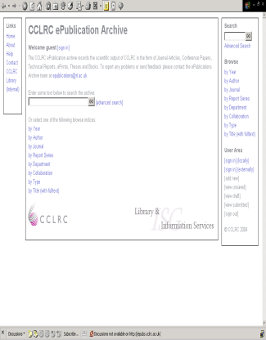
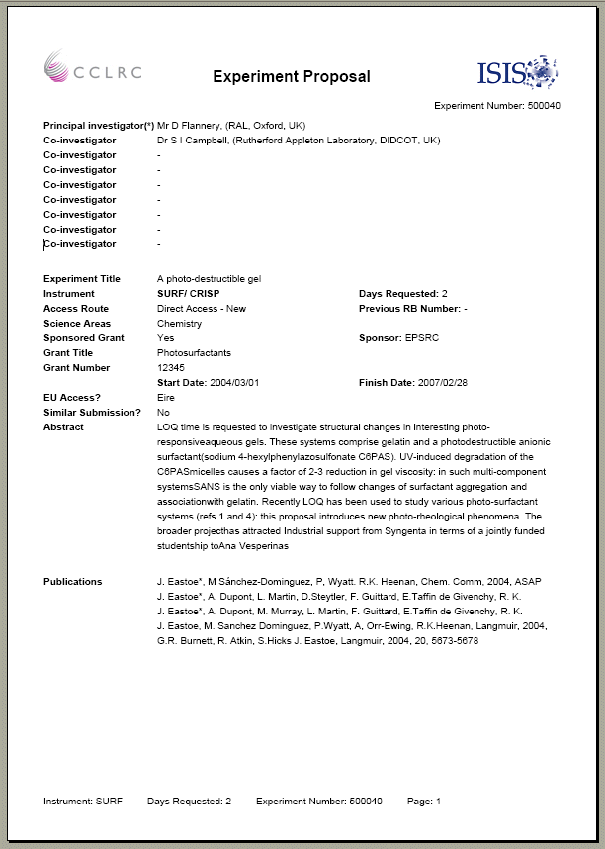
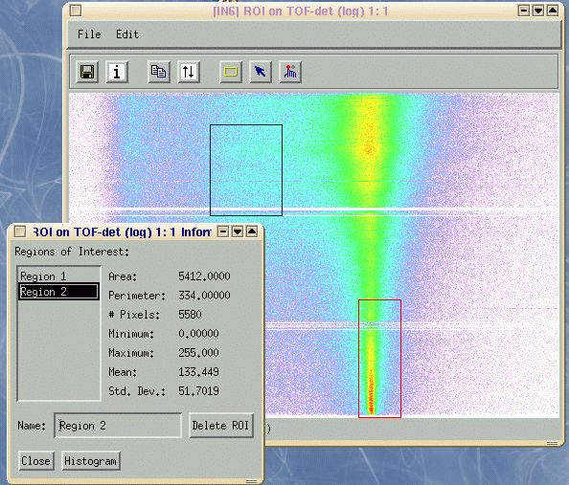
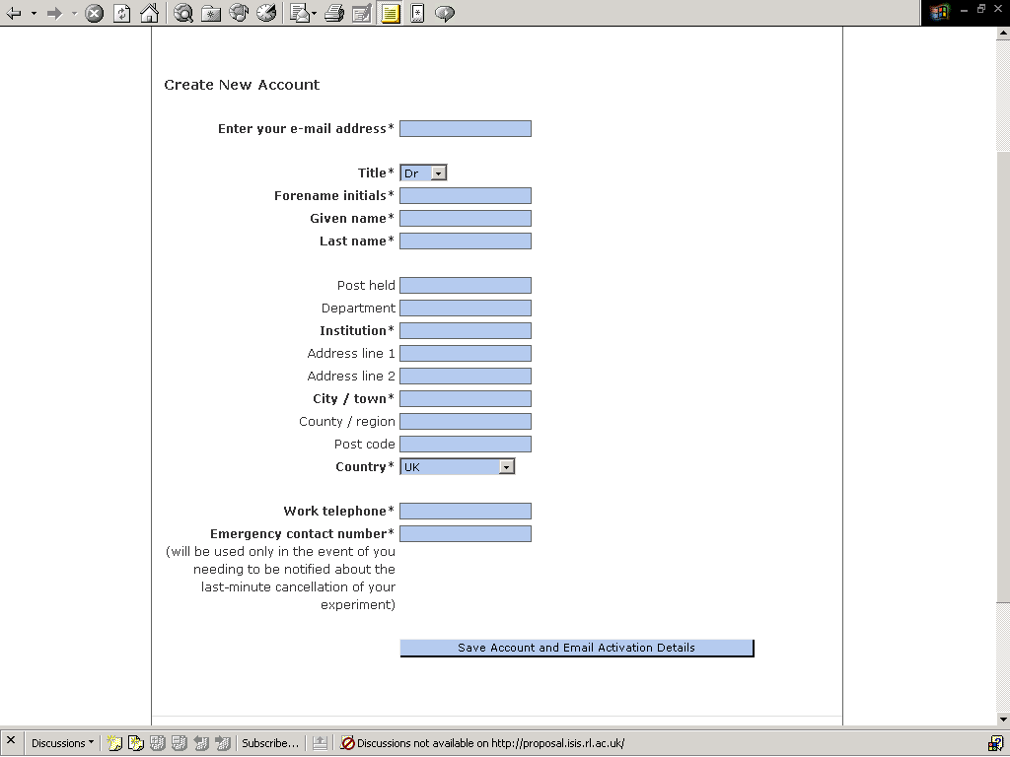
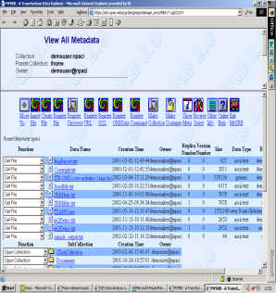
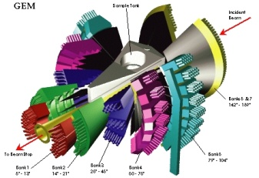
Facilities Data Lifecycle
Record Publication
Proposal
Approval
Subsequent publication registered with facility
Data analysis
Scientist submits application for beamtime
Scheduling
Data storage
Experiment
Tools for processing made available
Facility committee approves application
Raw data filtered, and stored
Scientists visits, facility run’s experiment
Facility registers, trains, and schedules scientist’s visit
http://code.google.com/p/icatproject/

Slide 5
Background – Research Data
What are the scalability issues?
STFC research data is complex rather than vast
Each ISIS instrument generates files with different semantics – there are 35 different instruments.
Linking experimental data, publications and analysed data
  Links may to be different places for each dataset and ensuring that these remain resolvable is an intellectual challenge even at a small scale.
Generating these links is a preservation activity in itself.

Slide 6
Investigation as a Research Object
Raw Data
:hasDataset
:investigator
Investigation #n
DOI:STFC.xxx
Derived Data
:hasRelatedDataset
:instrument
:hasPublication
Publications
:hasPublication
Own metadata format (Core Scientific Metadata Model CSMD)
OAI-ORE
W3C Prov ontology

Slide 7
Proposed architecture for Investigation Research Objects at STFC
Grey: infrastructure/tools already in use
Blue: tools which depend on local infrastructure
Green: proposed generic tools.

Slide 8
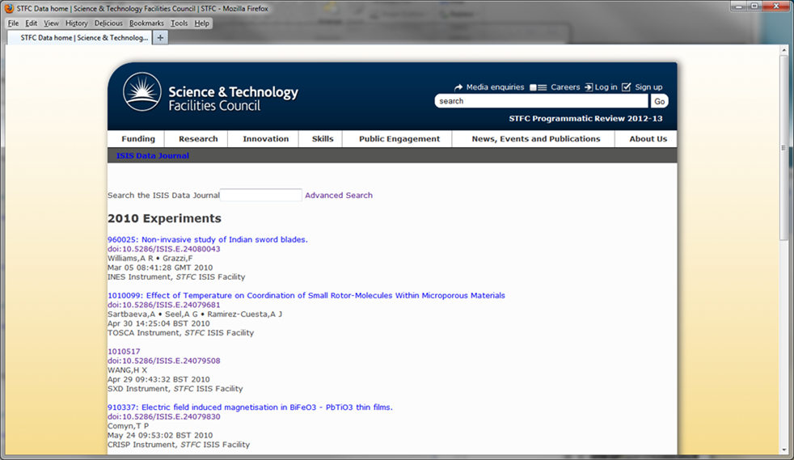
Mock up of ISIS data journal showing investigation research objects

Slide 9
Timetable
IRO builder under construction
RO validator next tool for development
  Hope to be able to use SCAPE Watch tool SCOUT for parts of this functionality

Slide 10
Thanks
For more information, contact Catherine.jones@stfc.ac.uk
This work is funded by the EU within the SCAPE project.
Other STFC staff who contributed to this work are:
  Alastair Duncan Vasily Bunakov
  Antony Wilson Shirley Crompton
  Brian Matthews

